Slide 1

DEPARTMENT OF COMPUTER SCIENCE & ENGINEERING
SCHOOL OF COMPUTING
1156CS601- MINOR PROJECT
WINTER SEMESTER(2022-2023)
REVIEW - I
“FRAUD CREDIT CARD DETECTION SYSTEM USING
MACHINE LEARNING ”
SUPERVISED BY
MS. K.ALAMELU
ASSOCIATE PROFESSOR
PRESENTED BY
1. NALLURI KARTHIK (VTU15337)(20UECS0659)
2. CHEELLA BALAJI (VTU17056)(20UECS0193)
3. K.LOKESH (VTU18313)(20UECS0452)
1

Slide 2
AGENDA
ABSTRACT
OBJECTIVE
INTRODUCTION
LITERATURE REVIEW
DESIGN AND METHODOLOGIES
IMPLEMENTATION
CONCLUSION
REFERENCES

Slide 3
ABSTRACT
Credit card fraud refers to the physical loss of credit
card or loss of sensitive credit card information.
Many machine learning algorithms can be used for detection.
This research shows several algorithms that can be used for classifying
transactions as fraud or genuine one.
Credit Card Fraud Detection dataset was used in the research.
Because the dataset was highly imbalanced, SMOTE technique was used for
oversampling.
Further, feature selection was performed and dataset was split into two parts, training data and test data. The algorithms used in the experiment were Logistic Regression,Support vector machine (SVM)

Slide 4
OBJECTIVES
Aim of the Project:
The aim of this project is to predict whether a credit card transaction is fraudulent or not, based on the transaction amount, location and other transaction related data. It aims to track down credit card transaction data, which is done by detecting anomalies in the transaction data.
Scope of the Project:
Modeling prior credit card transactions with data from ones that turned out to be fraudulent is part of the Card Fraud Detection Problem. In Machine learning the machine is trained at first to predict the output so, to predict the various bank transactions various machine learning algorithms are used.

Slide 5
INTRODUCTION
Credit card generally refers to a card that is assigned to the customer (cardholder), usually allowing them to purchase goods and services within credit limit or withdraw cash in advance.
Credit card provides the cardholder an advantage of the time, i.e., it provides time for their customers to repay later in a prescribed time, by carrying it to the next billing cycle.
Credit card frauds are easy targets. Without any risks, a significant amount can be withdrawn without the owner’s knowledge, in a short period.
Fraudsters always try to make every fraudulent transaction legitimate, which makes fraud detection very challenging and difficult task to detect.

Slide 6
LITERATURE REVIEW
Rimpal R. Popat with Jayesh Chaudhary: They madea survey on credit card fraud detection, considering the major areas of credit card fraud detection that are bankfraud, corporate fraud, Insurance fraud. With these theyhave focused on the two ways of credit card transactions i)Virtually (card, not present) ii) With Card or physically They had focused on the techniques which areRegression, classification, Logistic regression, Supportvector machine
Mohamad Zamini: purposed an unsupervised fraud detection method using autoencoder based clustering.Theautoencoder is anauto associatorneural network they haveused it to lower the dimensionality, extract the usefulfeatures, and increase the efficiency of learning in a neuralnetwork.
Dejan Varmedja:proposed the various machinelearning algorithms and analyzed them concerning to creditcard fraud detection methods. The various methods ofmachine learning are Logistic Regression, Naïve Bayes,Random Forest, Multilayer Perceptron. Here for multilayerperceptron (ANN) is used (Artificial neural network)

Slide 7
LITERATURE REVIEW
Sahil Dhankhad: They applied supervised machinelearning algorithms on the real-world data set and then usedthose algorithms to implement a super classifier usingensemble learning and thenthey compared the performanceof supervised algorithms with their implementation of a super classifier. They used ten machine learning algorithms such as Random Forest, Stacking Classifier, XGB Classifier,Gradient Boosting, Logistic Regression, MLP Classifier,SVM
Kuldeep Randhawa:They used twelve machinelearning algorithms for credit card fraud detection in whichtheir range standard from a neural network to deep learning.They are tracing the performance of bench mark and real world datasets.
Sai Kiran: proposed an improved algorithm for creditcard fraud detection. That is named as Naïve Bayes improved K-nearest Neighbor method (NBKNN).

Slide 8
DESIGN AND METHOLOGIES
MODULE 1:Requirement Analysis,System Design
MODULE 2:Coding,Implementation,Testing,Maintenance

Slide 9
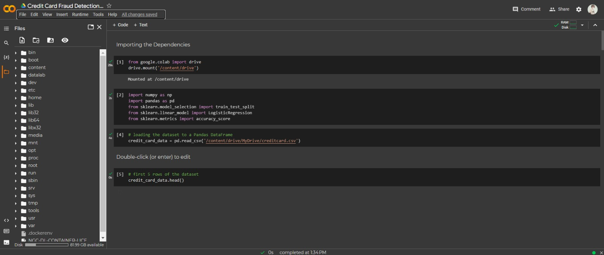
MODULE:1
Module 1 -Requirement Analysis
Step:1 Perform Exploratory Data Analysis (EDA)*
There are a total of 284,807 transactions with only 492 of them being fraud. Let’s import the necessary modules, load our dataset, and perform EDA on our dataset.

Slide 10
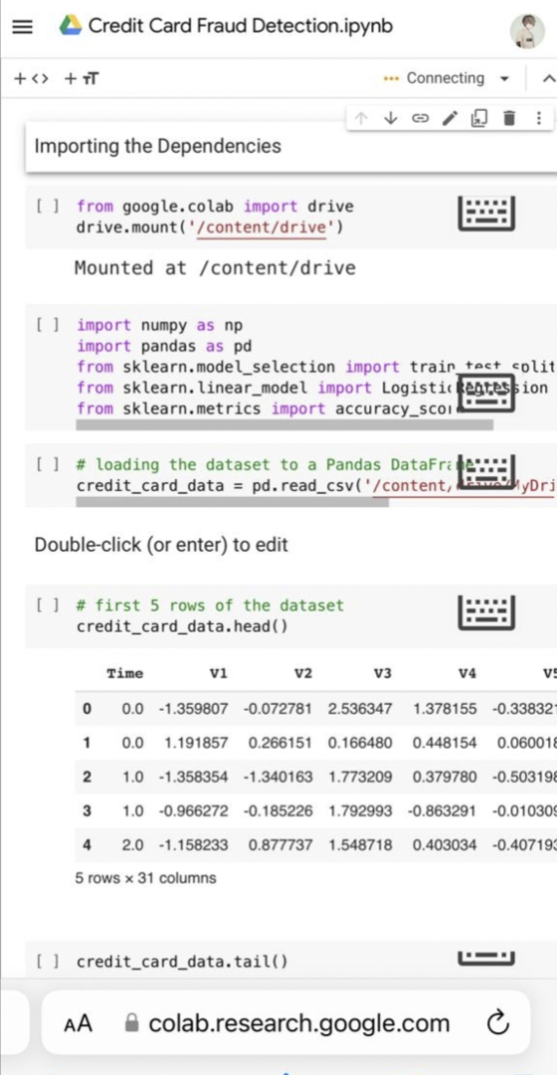
Step 2: Processing of data

Slide 11
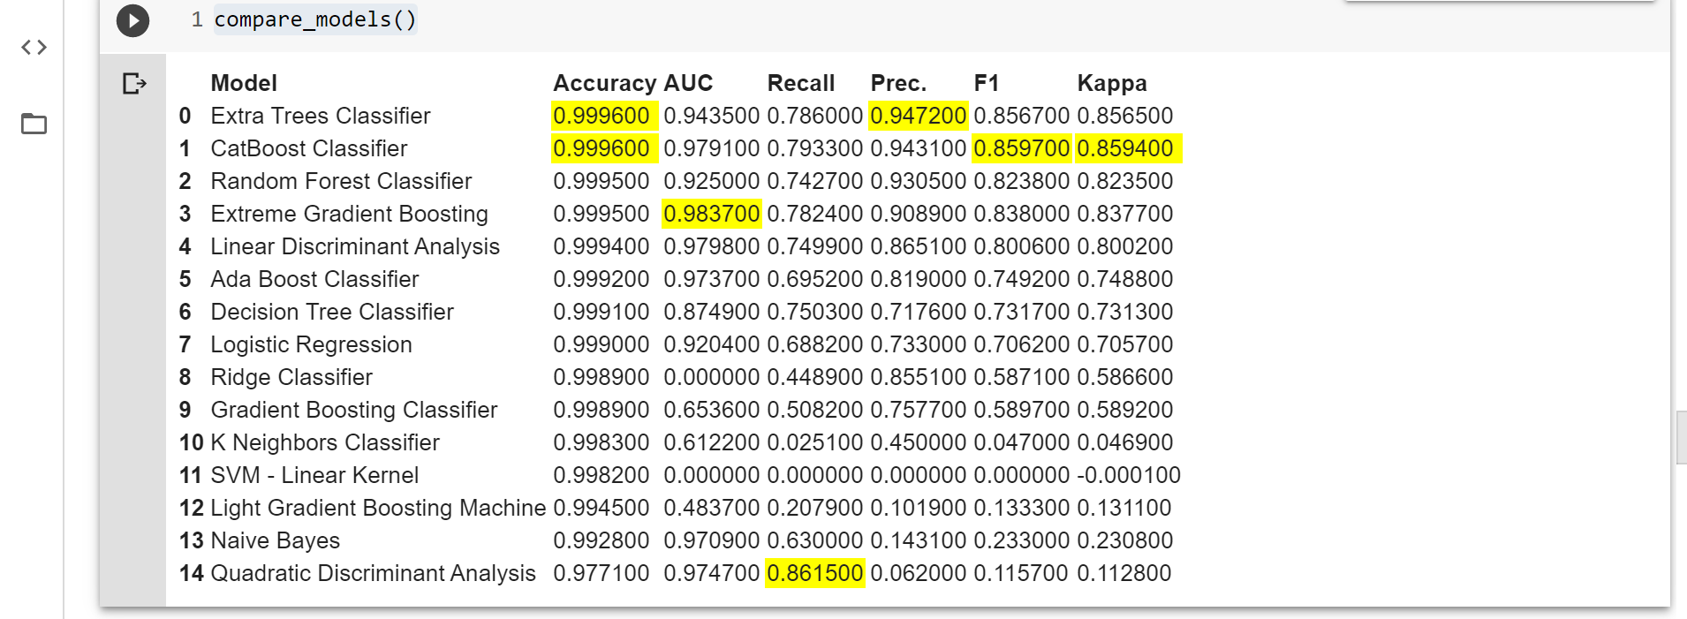
Step 3: Apply Machine Learning Algorithms to Credit Card Dataset

Slide 12

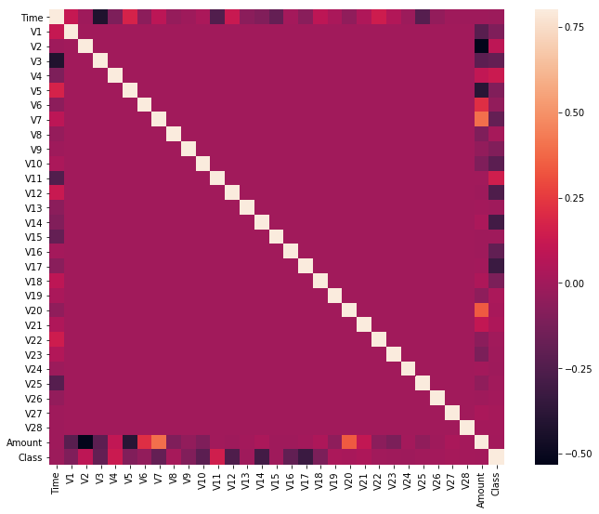
Step 4: Get the Output

Slide 13
IMPLEMENTATION
Architecture Diagram
Data –Flow Diagram
Use Case Diagram
Class Diagram
Activitiy Diagram
Sequence Diagram
Colloboration Diagram(If applicable)
E-R Diagram

Slide 14
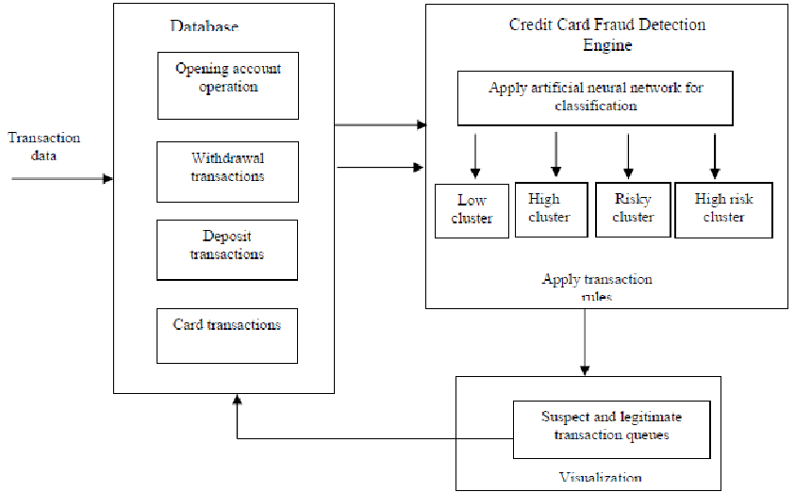
ARCHITECTURE DIAGRAM

Slide 15
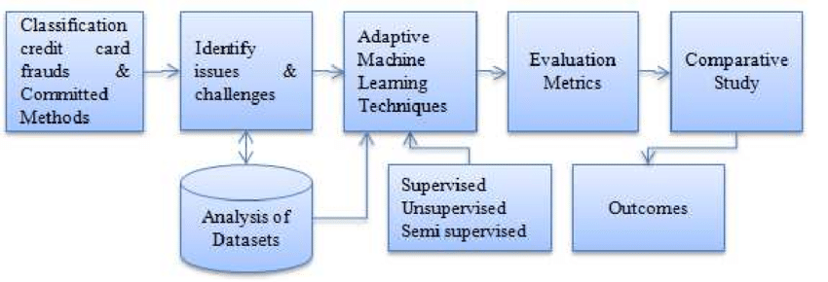
DATA FLOW DIAGRAM

Slide 16
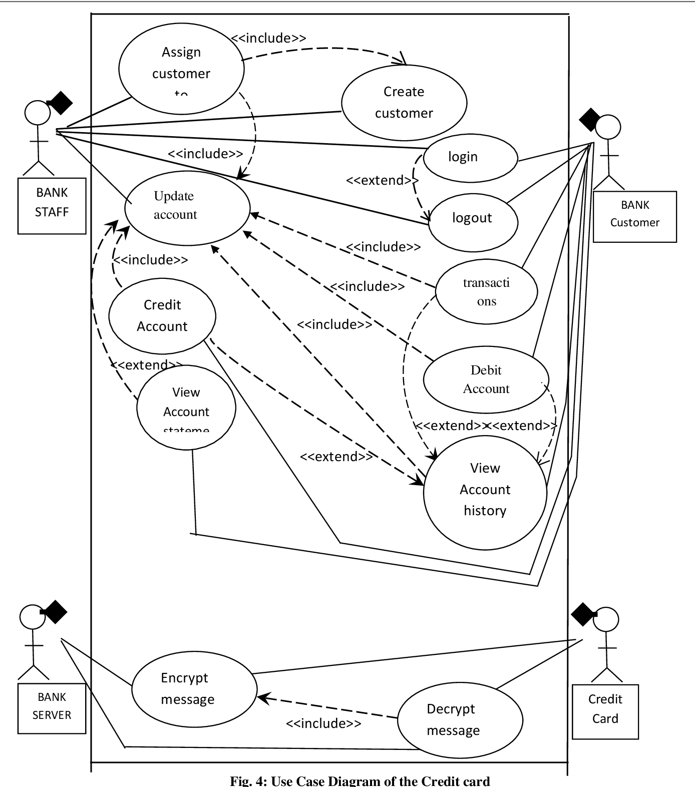
Use Case Diagram

Slide 17
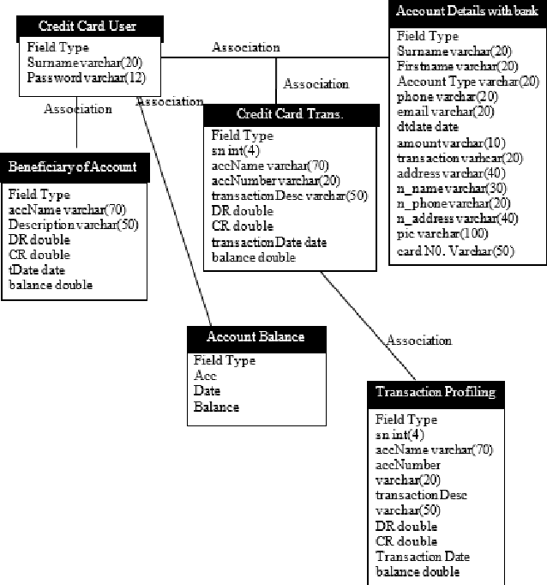
Class Diagram

Slide 18
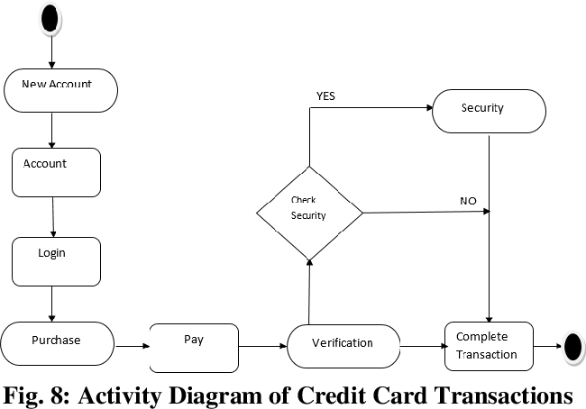
Activitiy Diagram

Slide 19
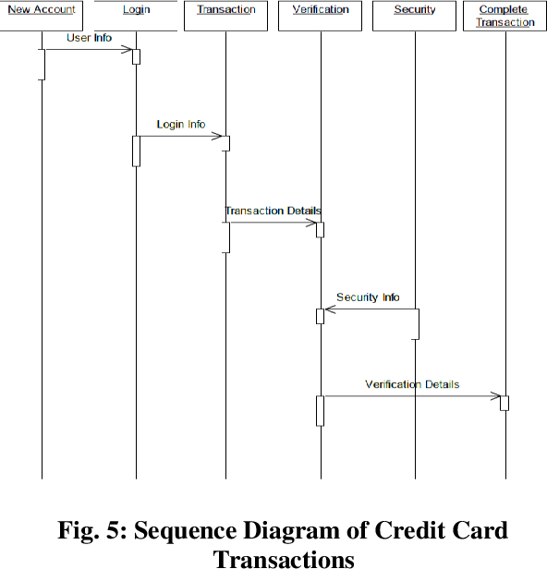
Sequence Diagram

Slide 20
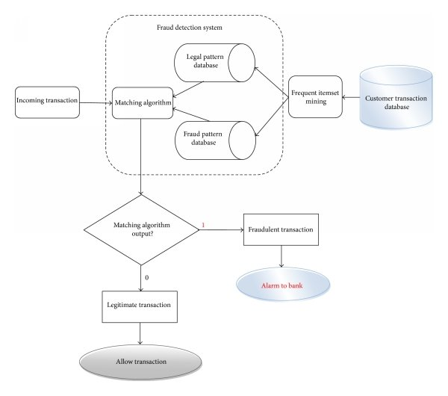
Colloboration Diagram(If applicable)

Slide 21
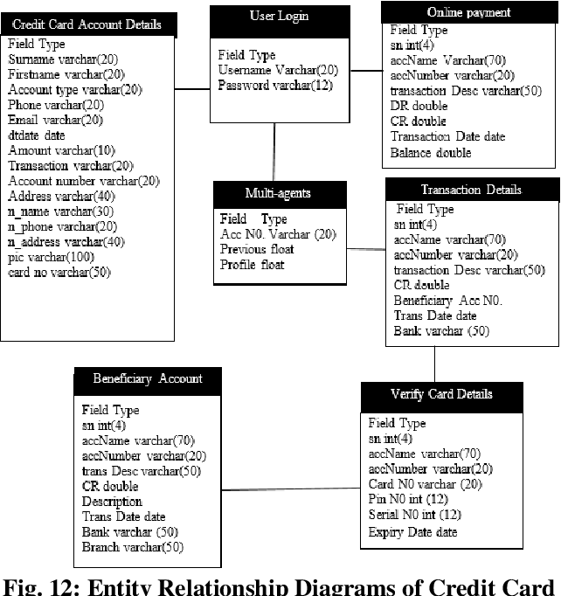
E-r dIAGRAM

Slide 22
CONCLUSION
Machine learning algorithms are used for credit card fraud detection. The power of machine learning is used to detect credit cards frauds and the performance of different machine learning algorithms is compared.Credit card fraud has without hesitation an expression of criminal deception. Fraud identification seems to be a complicated problem that requires a significant amount of skill until throwing algorithms regarding machine learning into it. Hence, comparison was made and it was established that Random Forest algorithm gives the best results i.e. best classifies whether transactions are fraud or not.

Slide 23
REFERENCES
Awoyemi, J.O., Adetunmbi, A.O. and Oluwadare, S.A., 2017, October. Credit card fraud detection using machine learning techniques: A co parative analysis. In 2017 International Conference on Computing Networking and Informatics (ICCNI) (pp. 1-9). IEEE
Shiyang Xuan, Guanjun Liu, Zhenchuan Li, Lutao Zheng, Shuo Wang, Changjun Jiang, Random Forest for Credit Card Fraud Detection,2018 (IEEE).
Arsenovic, and Andras Anderla,Credit Card Fraud Detection -Machine Learning methods, Publish in:18th International Symposium INFOTEH-JAHORINA, 20-22 March 2019 (IEEE).
Shantanu Rajora, Dong-Lin Li, Chandan Jha, Neha Bharill, Om Prakash Patel, Sudhanshu Joshi, Deepak Puthal, Mukesh Prasad,A Fraud Detection Based on Time Variance,2018 (IEEE).

Slide 24
Rimpal R. Popat and Jayesh Chaudhary,A Survey on Credit Card Fraud Detection using Machine Learning, 2018 (IEEE), pp. 1120 -1125
Changjun Jiang, Jiahui Song, Guanjun Liu, Member, IEEE, Lutao Zheng, and Wenjing Luan,Credit Card Fraud Detection: A Novel Approach Using Aggregation Strategy and Feedback Mechanism,2018 (IEEE), pp. 2327-4662.
Shail Machine, Emad A. Mohamad, Behrouz Far,Supervised Machine Learning Algorithms for Credit Card Fraudulent Transaction Detection: A Comparative Study, 2018(IEEE) computer society, pp.122-125.
N. K. Gyamfi and J. Abdulai, "Bank Fraud Detection Using Support Vector Machine," 2018 IEEE 9th Annual Information Technology, Electronics and Mobile Communication Conference (IEMCON), Vancouver, BC, 2018, pp. 37-41. doi: 10.1109/IEMCON.2018.8614994

Slide 25
THANK YOU

